Slide 1









Introduction to the course
Basics statistics for biomedical research
UEB – VHIR & GRBIO
Marta Bofill¹, Jordi Cortés¹, Santiago Pérez-Hoyos^{2,3},Àlex Sánchez^{2,3}
1 Departament d'Estadística i Investigació Operativa. UPC
2. Unitat d’Estadística i Bioinformàtica (UEB) VHIR
3 Departament de Genètica, Microbiologia i Estadística UB

Slide 2
Contingut
Who are we?
What do we do?
Where are we?
Why this course
Objectives
Methods
Contents
Logistics

Slide 3

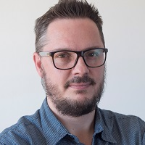
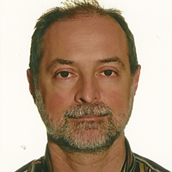

Who are we?
This is a joint course taught by members of the Grup de Recerca en Bioestadistica i Bioinformatica (GRBIO) (http://grbio.upc.edu)
GRBIO
EIO, UPC
GME, UPC
UEB, VHIR

Slide 4
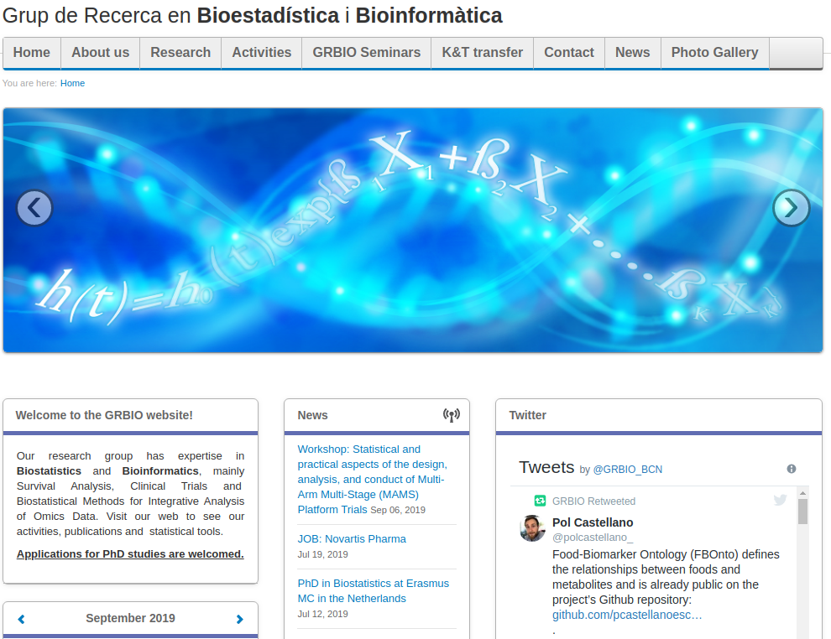
The GRBIO (http://grbio.upc.edu)

Slide 5
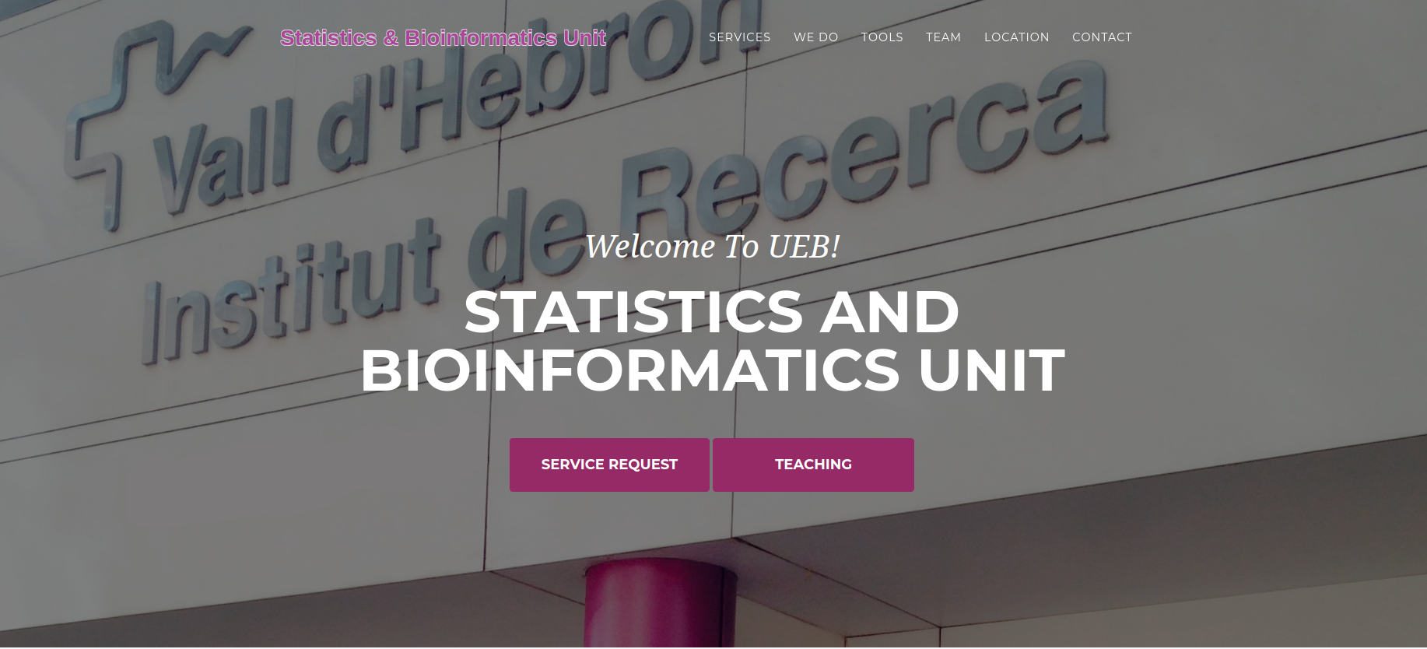
The UEB (http://ueb.vhir.org)
Notes:
Provide statistical, methodological and bioinformatic support for biomedical and clinical research, mainly in the VH but also to other scientists.
Contribute to training in statistics and bioinformatics for clinical and biomedical researchers by teaching a variety of courses ranging from one-day to teaching in the VHIR’s Msc.
Promote and be actively involved in innovation and development in statistics and bioinformatics, specially in anything that may revert in improvement of the unit’s mission development.

Slide 6
Why this course
A huge quantity of, often complex, data is generated in clinical or lab research.
In order to be able to extract information from data we must rely on… Statistics!!!
Statistical methods and tools range from those that are relatively simple and accessible to more complex sophisticated models.

Slide 7
So what?
The main goal of this course is to provide an overview which is good enough to…
Help you to analyze your own data, when it makes sense,
Suggests you contact us (or other experts) when it makes sense.
Learn when to do either thing :-)

Slide 8
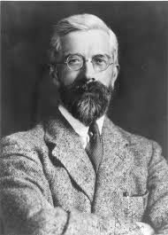
As the master said ...
“Hiring a statistician after de data has been collected is like hiring a physician when a patient is in the morgue: she might be able to tell you what went wrong , but she is unlikely to be able to fix it”
R.A. Fisher (or was it George Box?)

Slide 9
Objectives
Main objective of the course is to provide a general overview of the principal statistical methods that can be useful in biomedical research and daily practise
At the end of the course you should be able to...
Recognize the main problems from a statistical point of view.
Identify the basic methods to solve these problems.
Use basic tools to carry out your own analysis.
Identify when to apply each method.
Know whn you need to ask a professional statistician, using the proper terminology, to understand the solutions when problems increase their complexity.

Slide 10
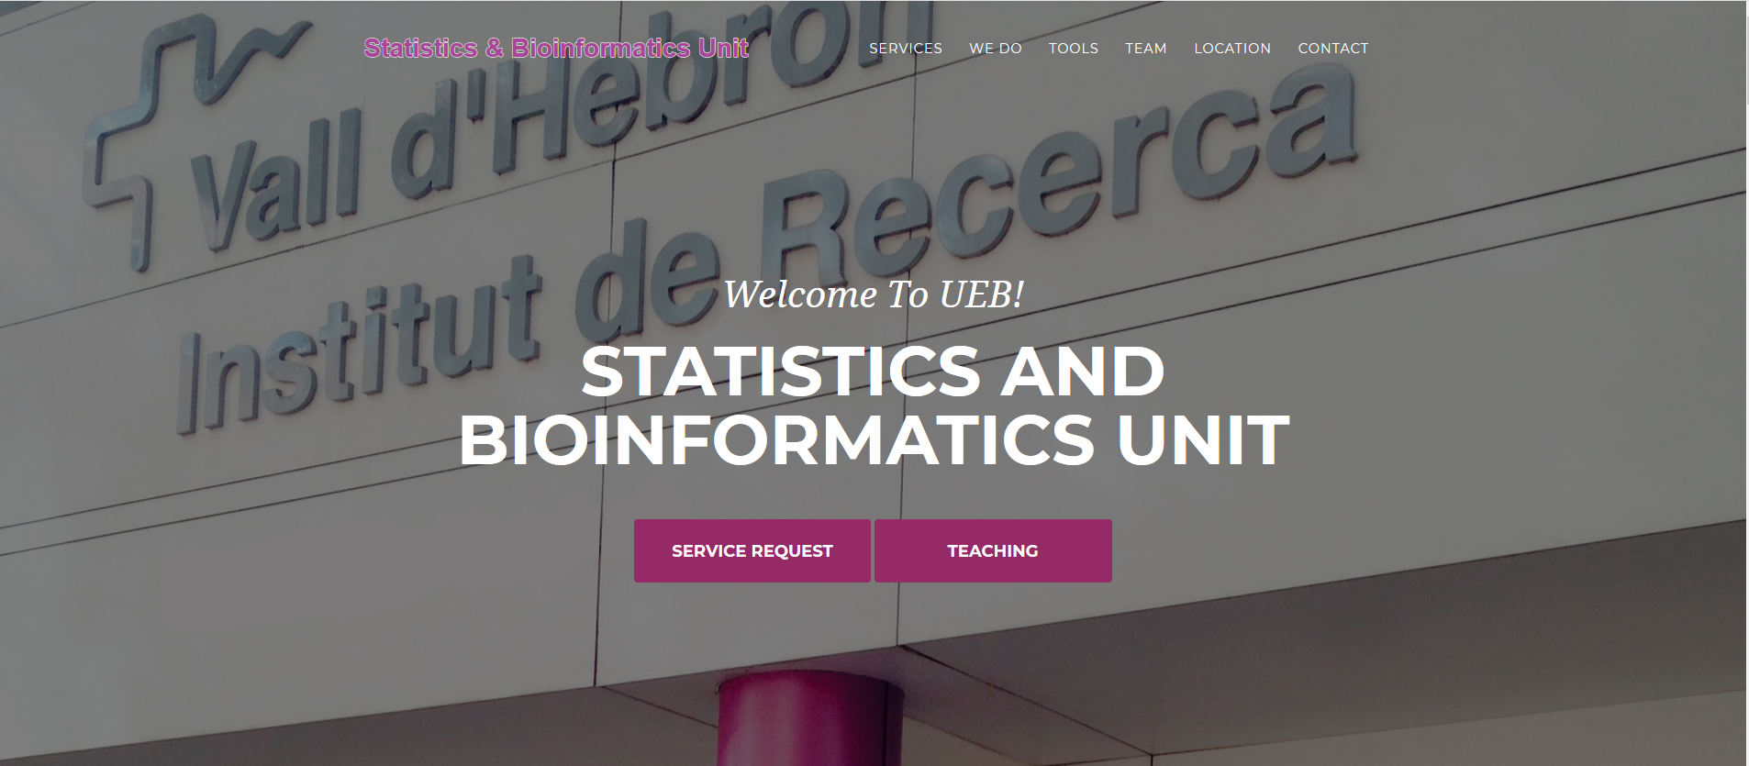
Course web page

Slide 11
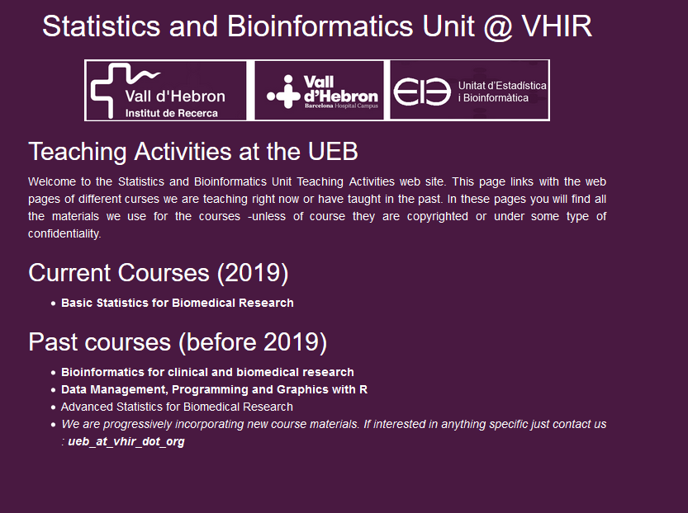
Course web page

Slide 12
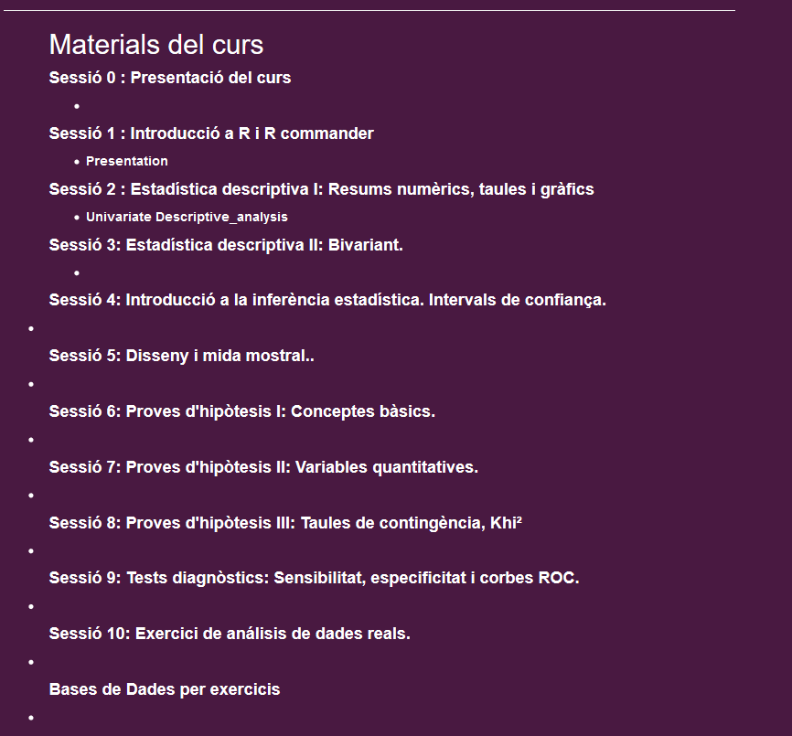

Slide 13
Methodology
This course is about applied statistics
We work with real data examples
Data analysis with R and R commander.
Theory is important , but discussion of real problems is what leads to understanding.
Program is flexible and may be adapted to your needs.

Slide 14



The statistical (scientifical?) process
Nature
Real data
generates …
“Studied nature”
Statistical methods
Observed data

Slide 15
Statistical approaches
Goal
Statistics
Descript
Estimation
Summary measures, Graphics, Confidence Intervals
Hypothesis testing
Compare
Relate or predict
Modelling or Regression

Slide 16
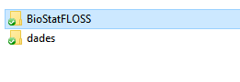
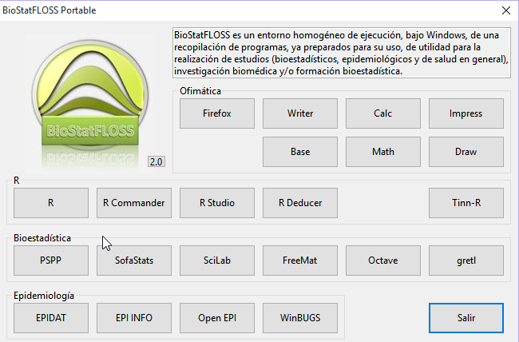
Materials

Slide 17
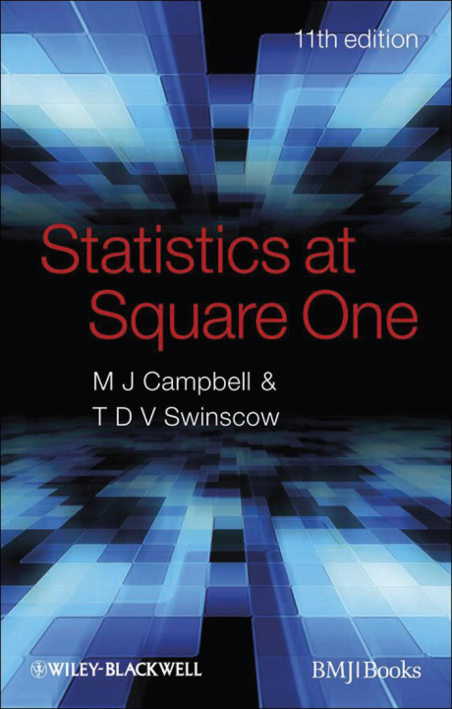
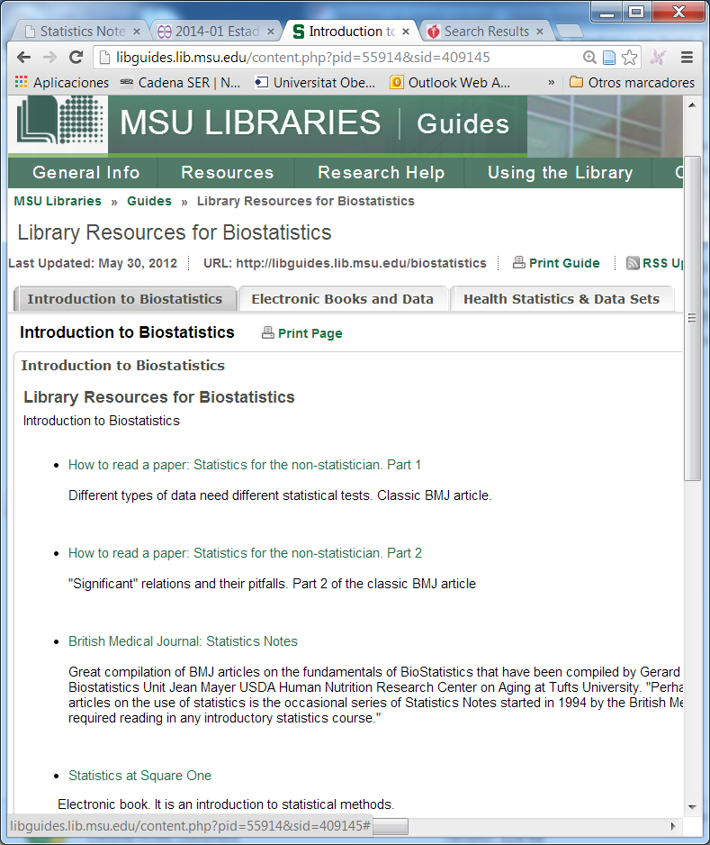
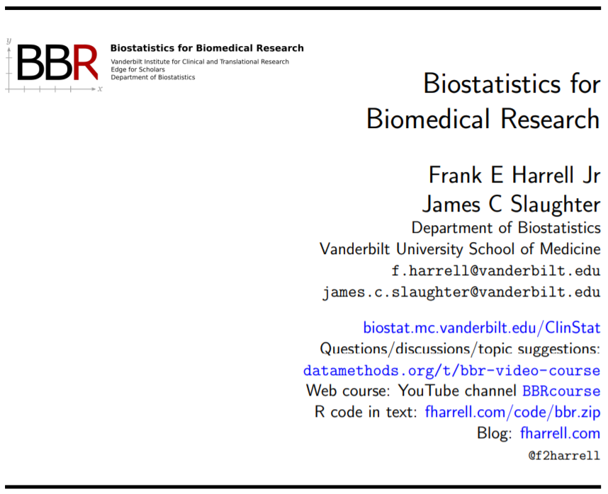
Resources
R and R-commander: Free software
Resources about basic statistics
Course slides and exercise datasets
Free books and other reference materials

Slide 18
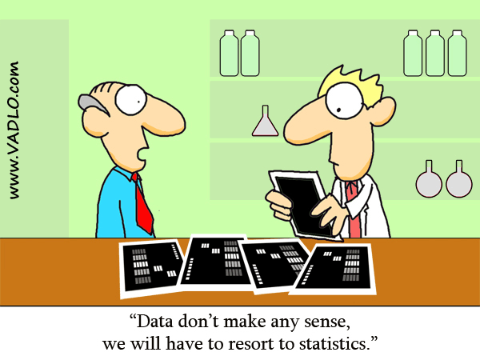
Enjoy the course !!!

